Slide 1


SMART CHAT
Secure, Seamless Communication for Everyone, Anywhere.
Supervised by: Dr. Hussein Nasrallah
Committee: Dr. Nour Akkad

Slide 2

Introduction
SMART CHAT

Slide 3
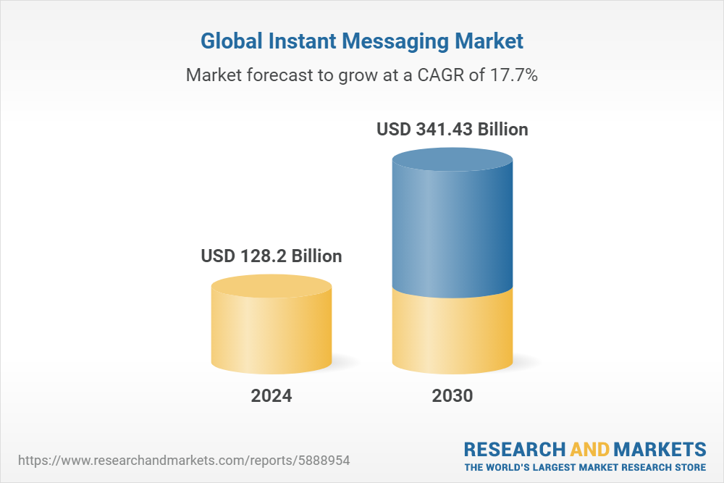
BACKGROUND
The global instant messaging market is projected to grow significantly, reaching a market value of USD 341.43 billion by 2030, up from USD 128.2 billion in 2024.

Slide 4
Motivation
We believe everyone deserves effortless, seamless communication to stay connected with the people who matter most. Smart Chat offers a secure, user-friendly platform for both personal and professional interactions that is packed with the latest Ai technologies.

Slide 5
POSED PROBLEM
Security
Accessibility
Seamless Communication

Slide 6


SIMILAR SYSTEMS
S
Discord
WhatsApp
Telegram
Feature-rich but cluttered
lacks end-to-end encryption
suited for gamers and tech-savvy users
user-friendly
Sells private data to advertisers.
Accessible to all users
Clean and smooth UI .
Offers strong privacy with secret chats and end-to-end encryption.
Accessible to all users

Slide 7
PROPOSED
SOLUTION
Smart Chat provides secure, real-time messaging for individuals and groups.
Ensures privacy and data protection through encryption.
Accessible across devices with a user-friendly interface.

Slide 8
SYSTEM DESIGN

Slide 9





Implementation Tools
Storage, Messaging service/Auth
JAVA,XML
App
Client Side
Server Side
Android Studio
Firebase
UI/UX
Call Service
Google ML Kit/ Gemini Ai

Slide 10
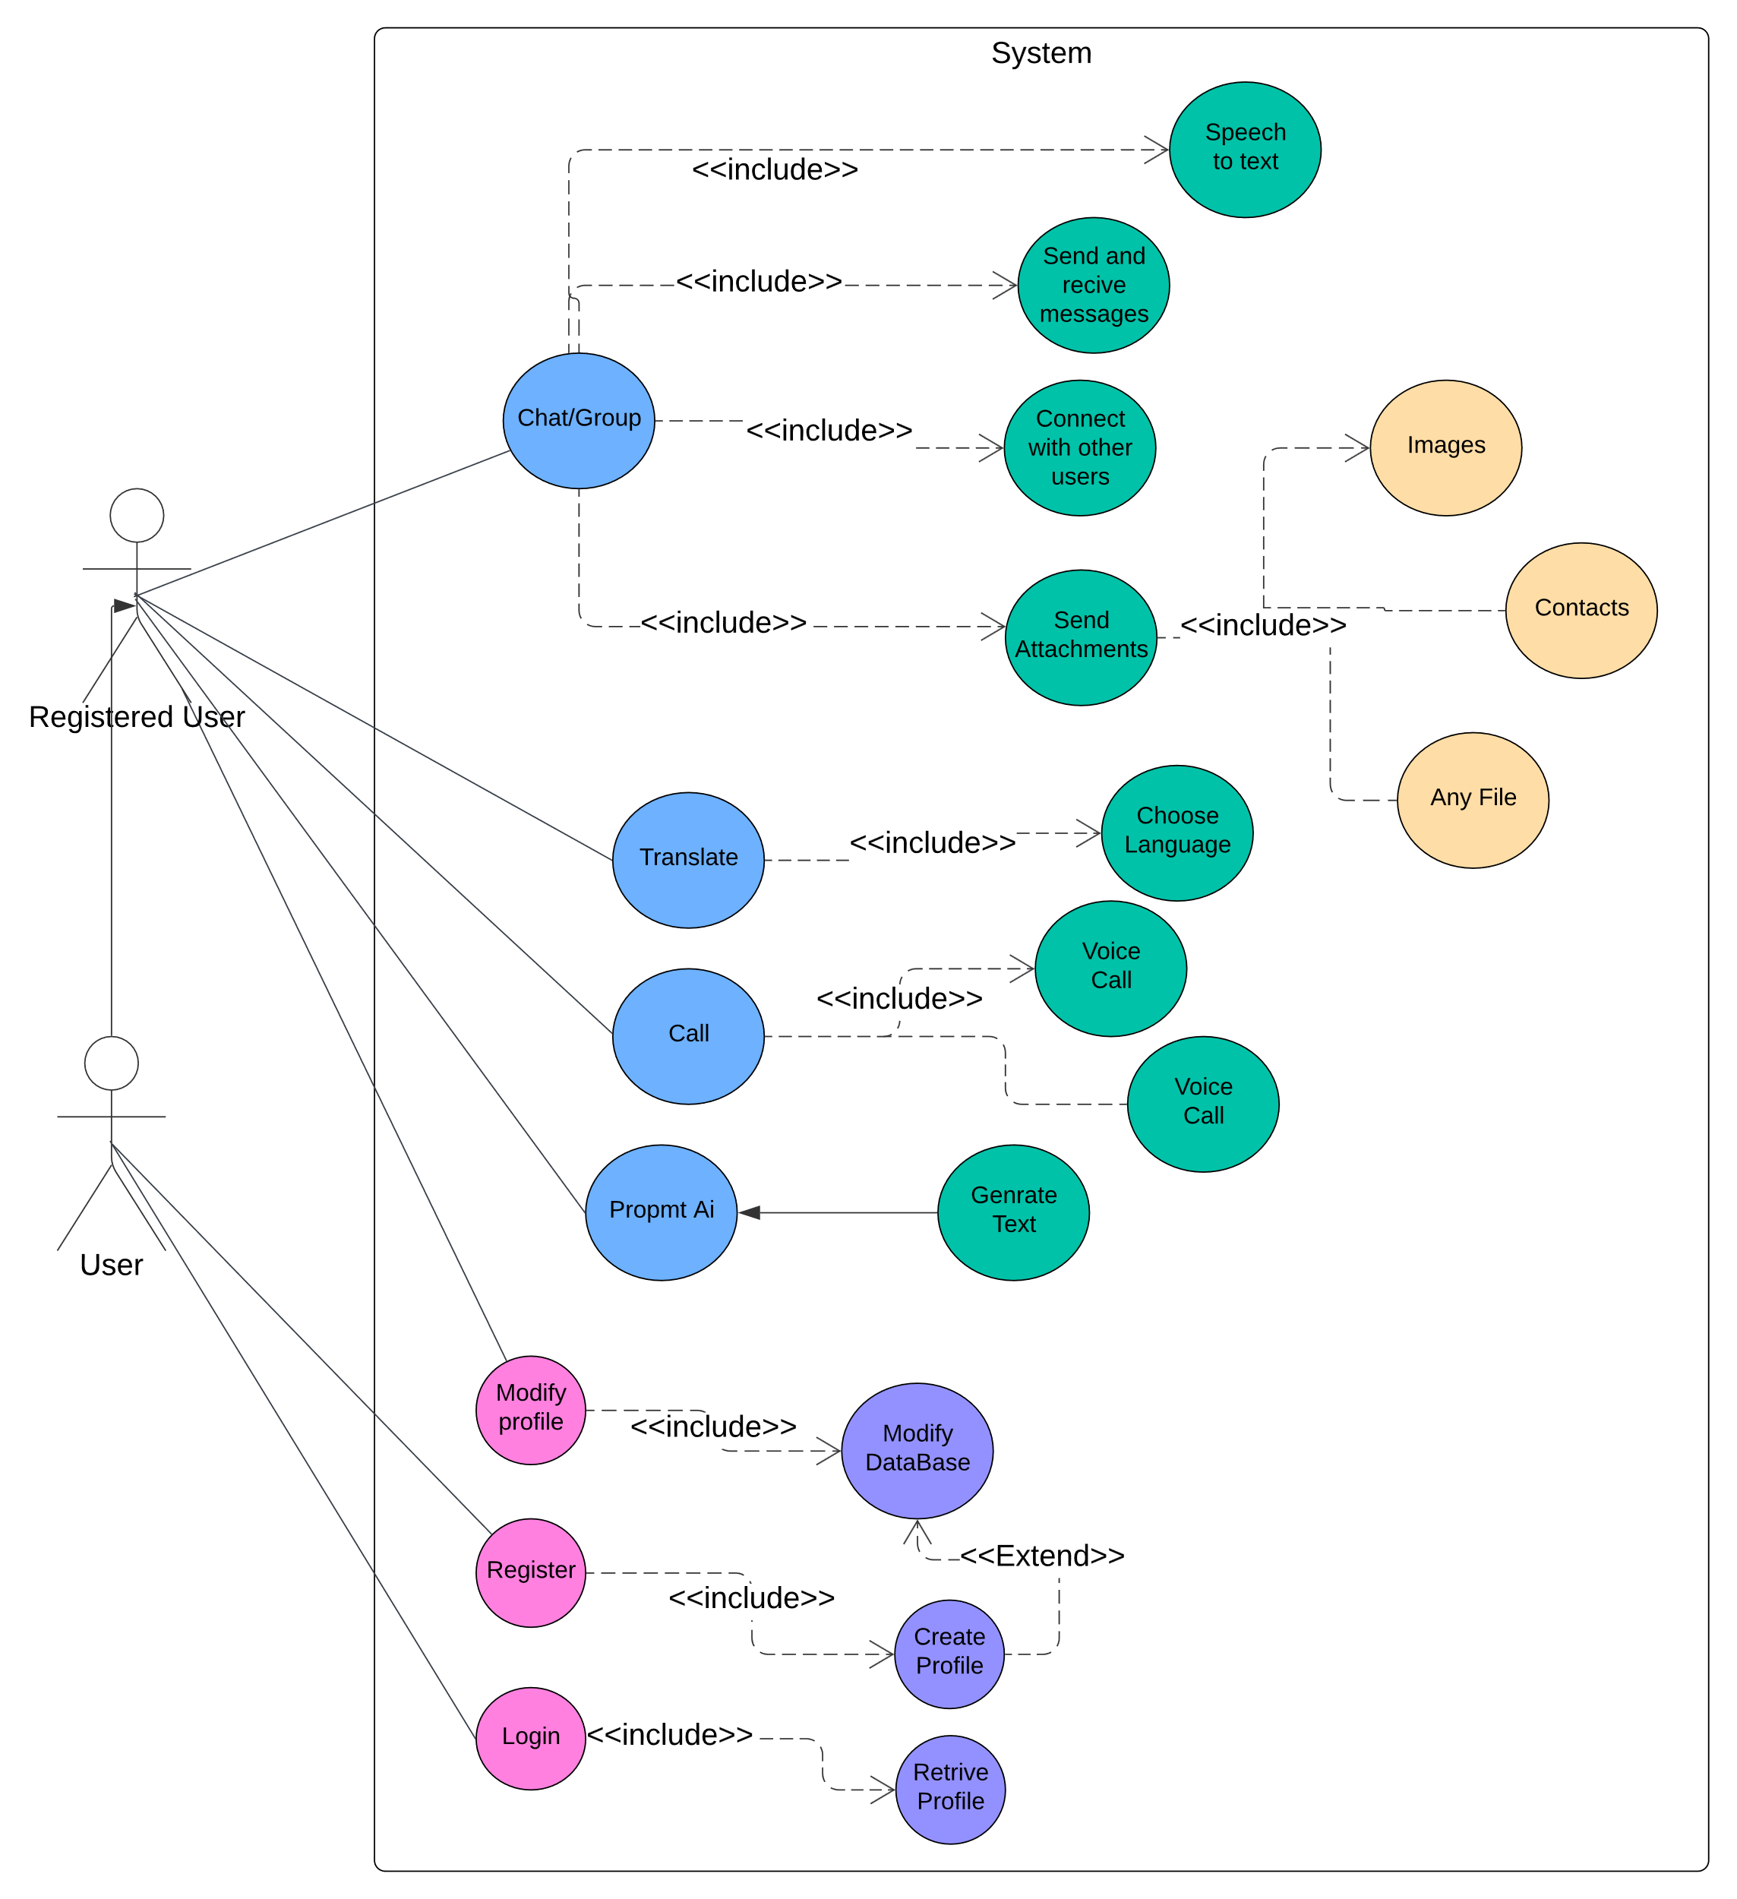
Use Case Diagram

Slide 11
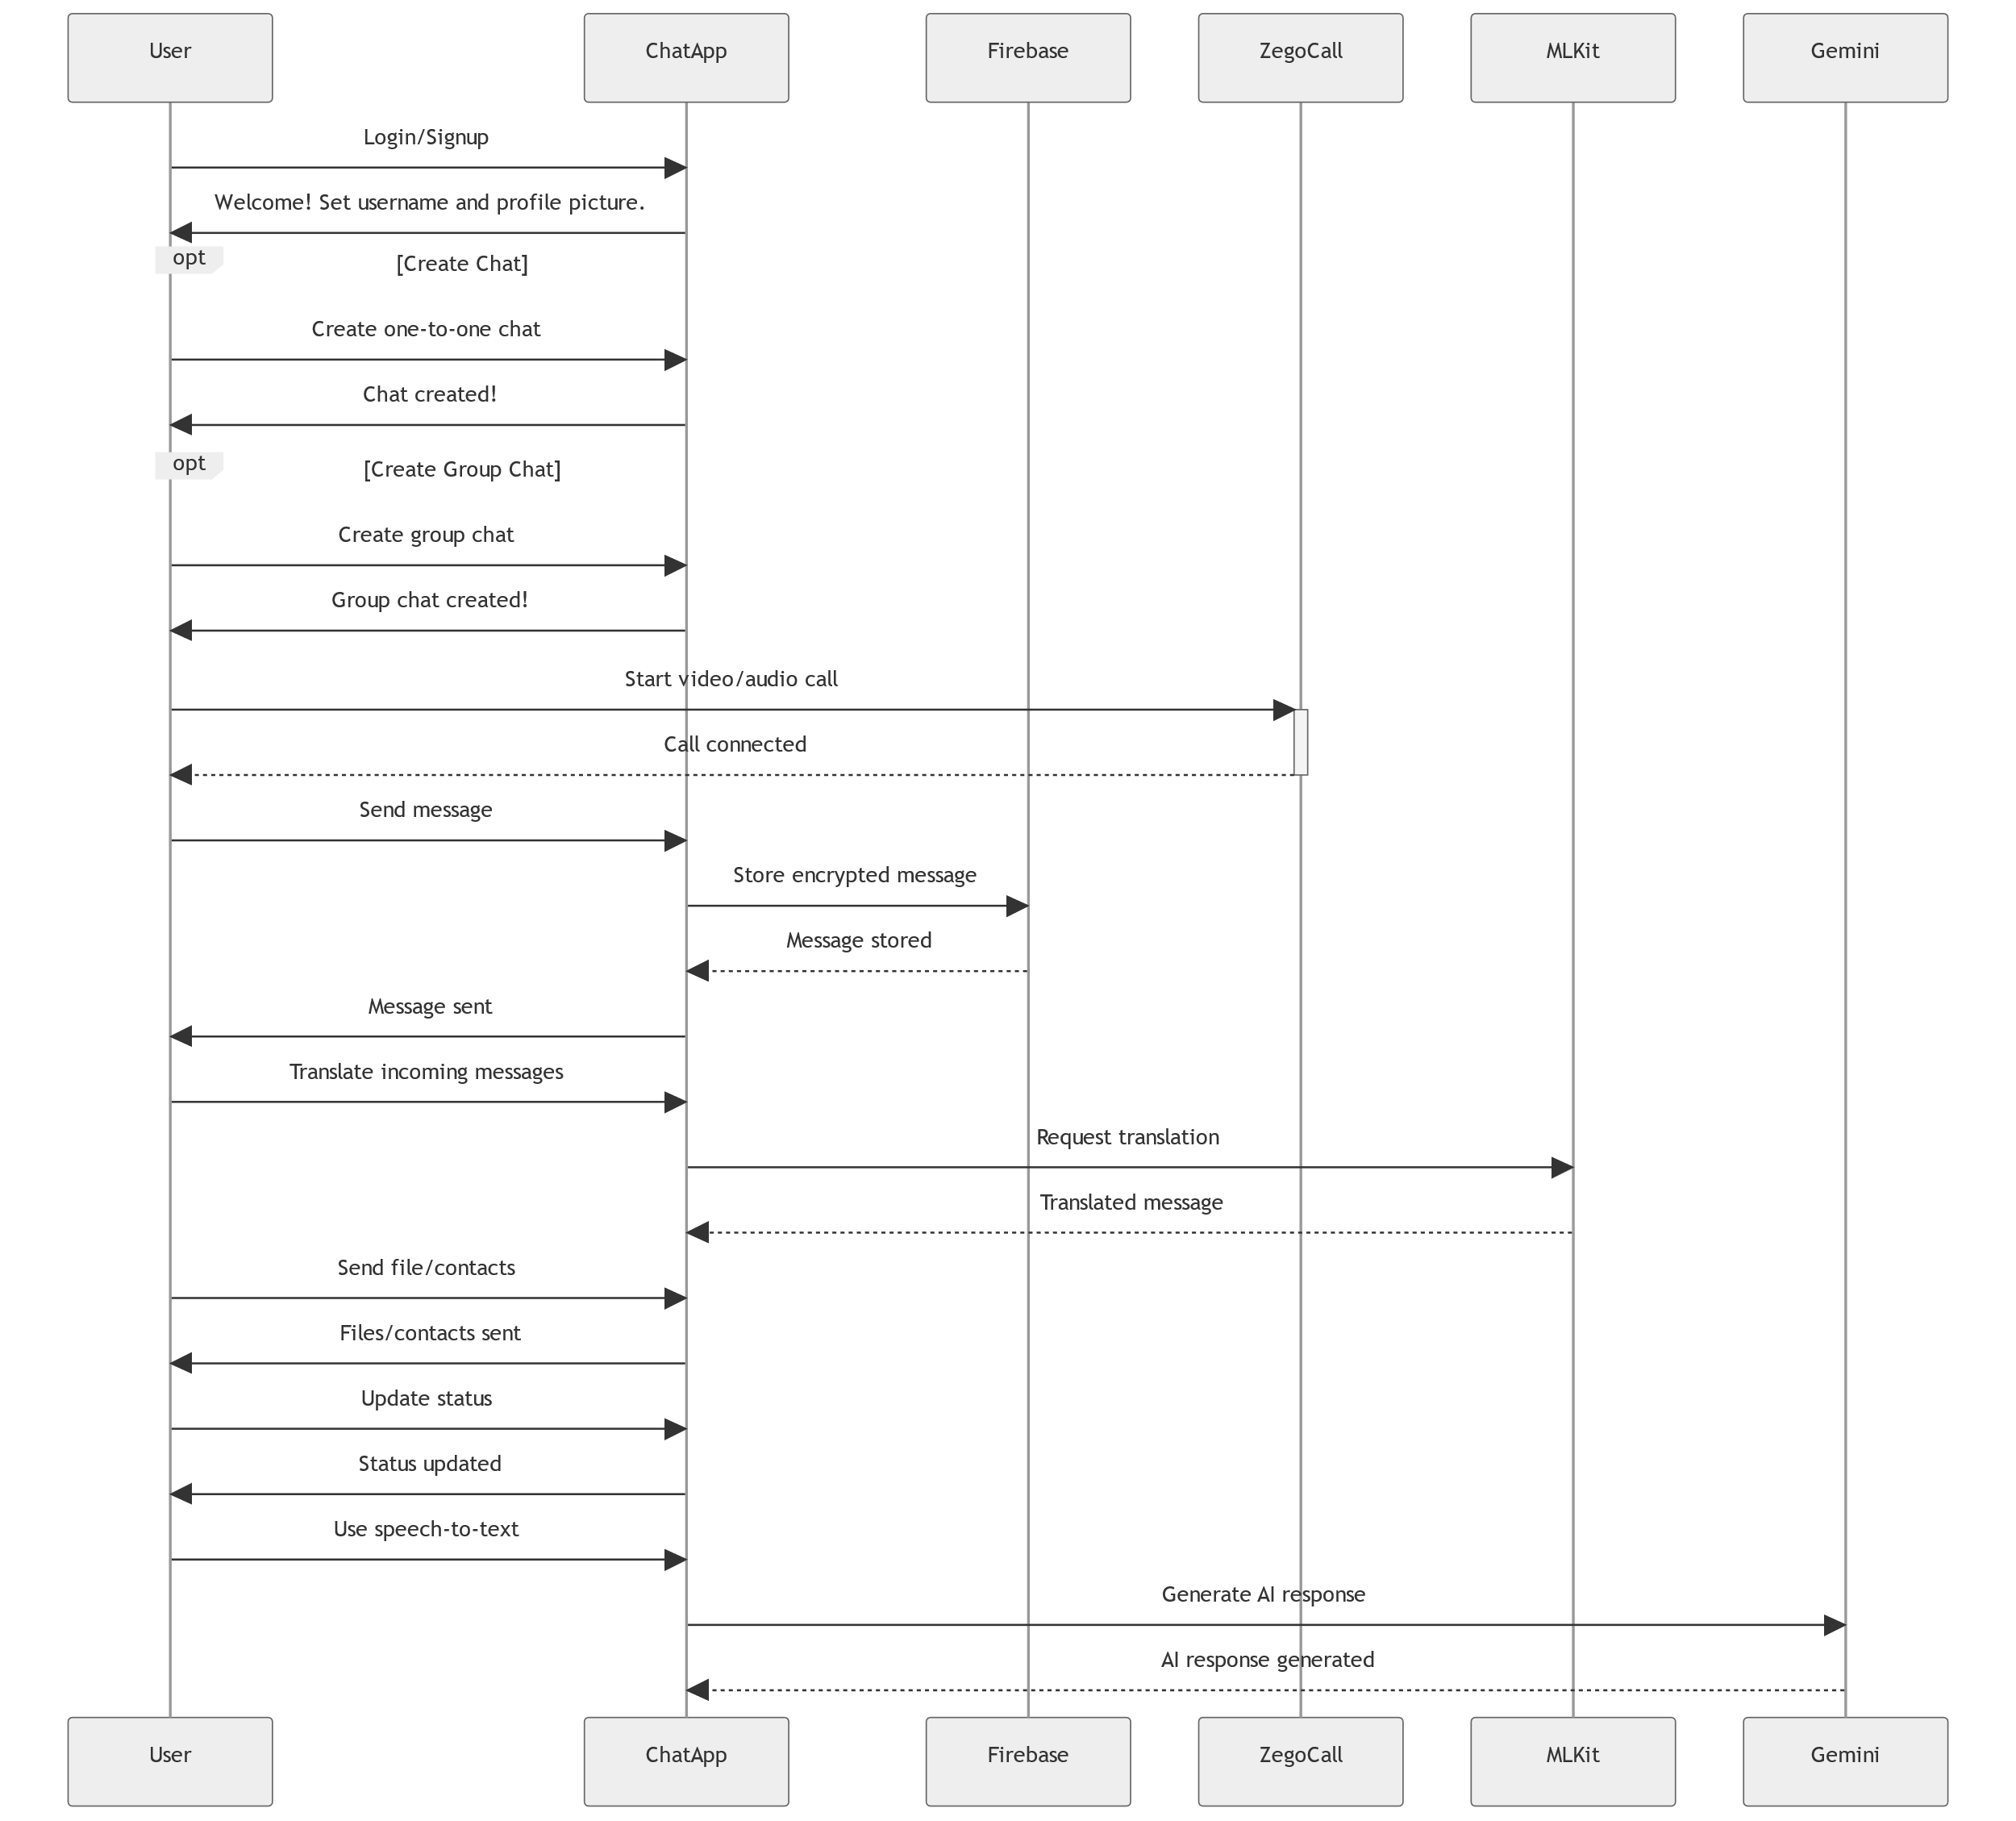
Global Sequence Diagram

Slide 12

Future Work
03
Ai image
generation
Communities
04
Voice Messages
Location
sharing

Slide 13

Question Time
Thank you!
Firas Khadra 72030278@students.liu.edu.lb
Sadek Mhanna 72030823@students.liu.edu.lb

